Slide 1

Indian Institute of Technology , Patna
Topic : Convolution Neural Network
Presented By :
Rutuj Waghare (2111MC10)
M.Tech – Mathematics and Computing
Guided By :
Dr. Prashant Srivastava
Associate Professor
Department of Mathematics
[1]

Slide 2
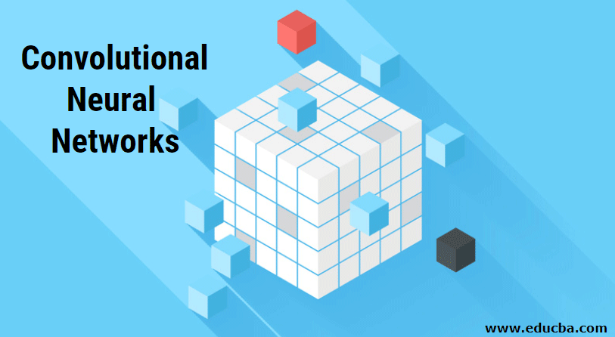
[2]
source : educba.com

Slide 3
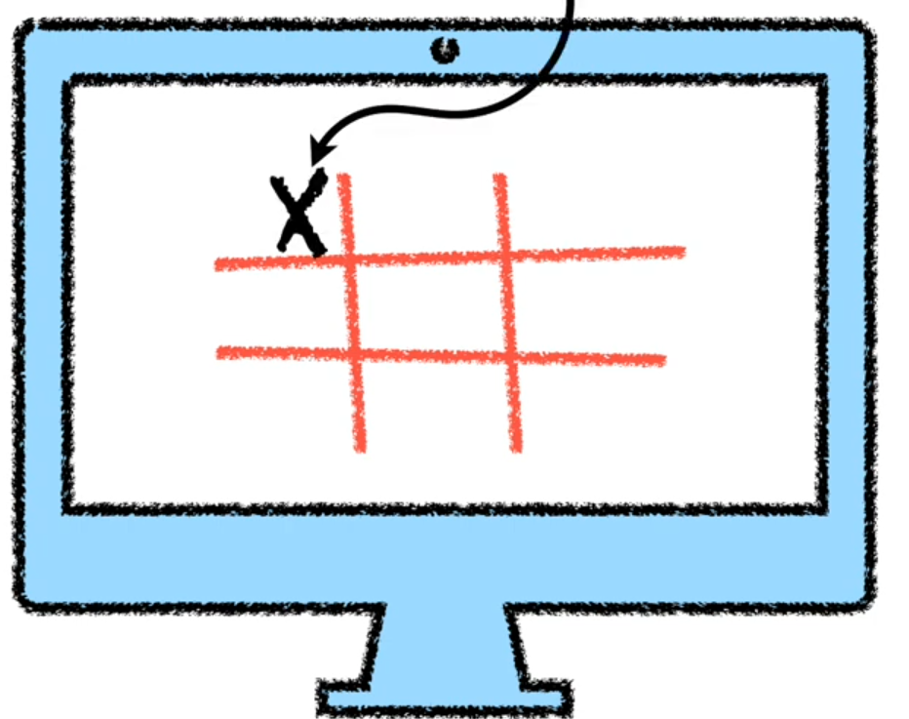
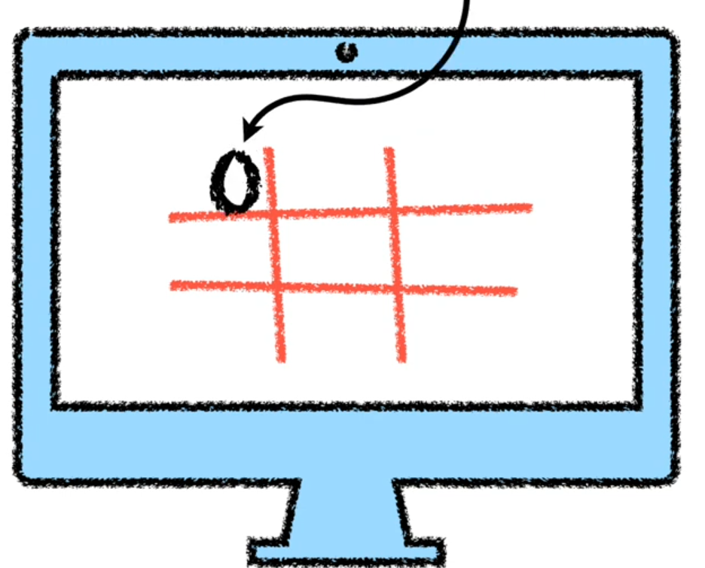
[3]

Slide 4
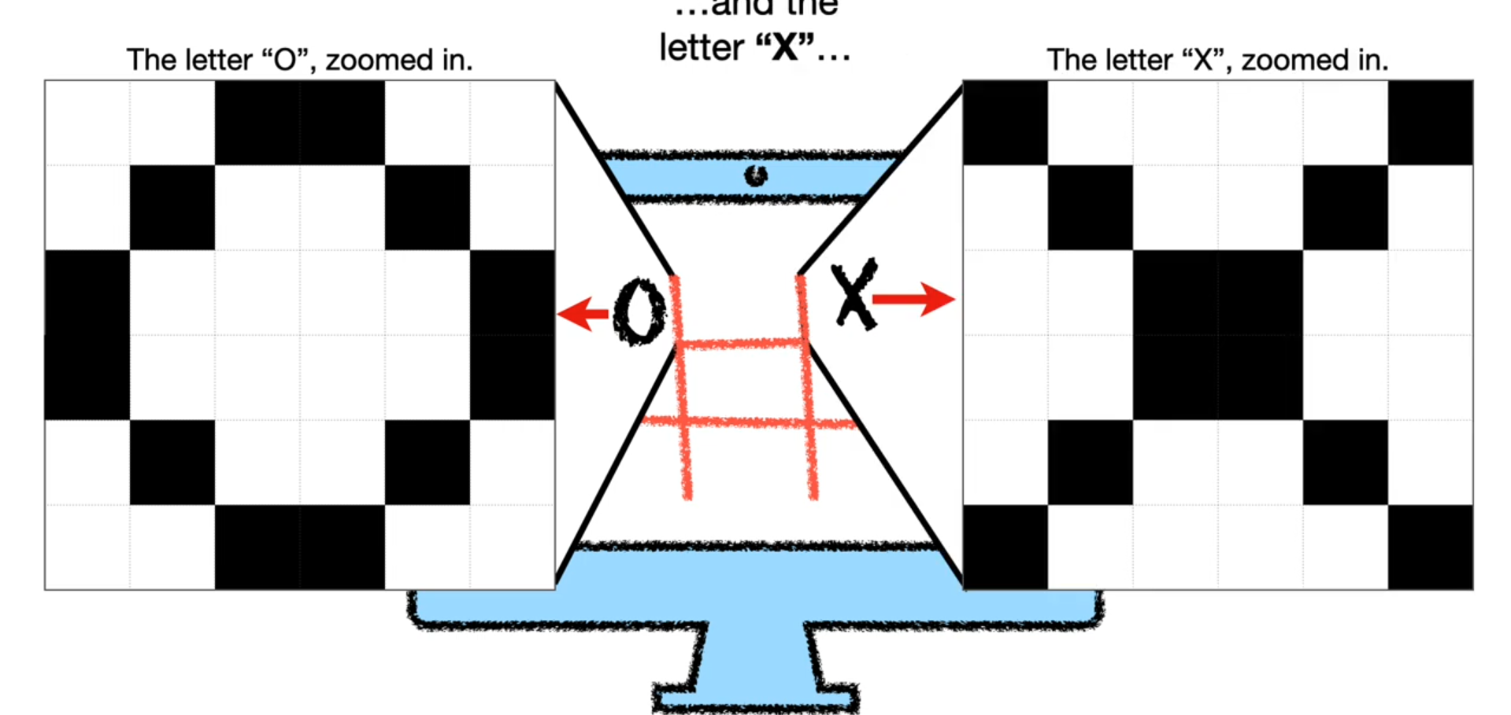
[4]
source : statquest

Slide 5
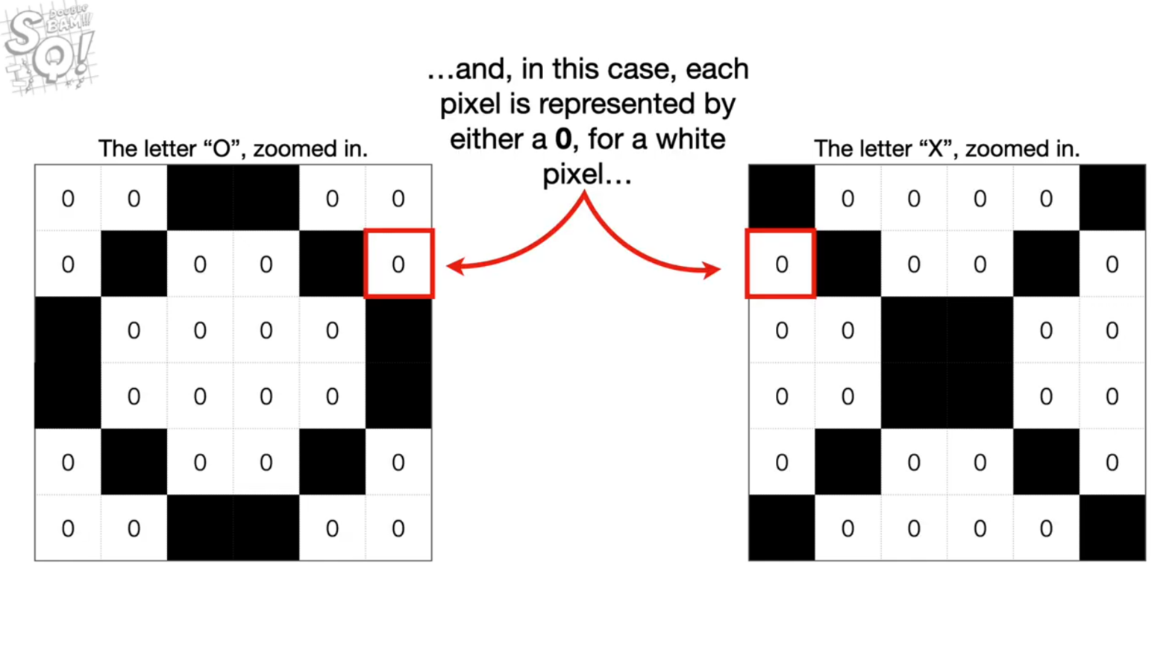
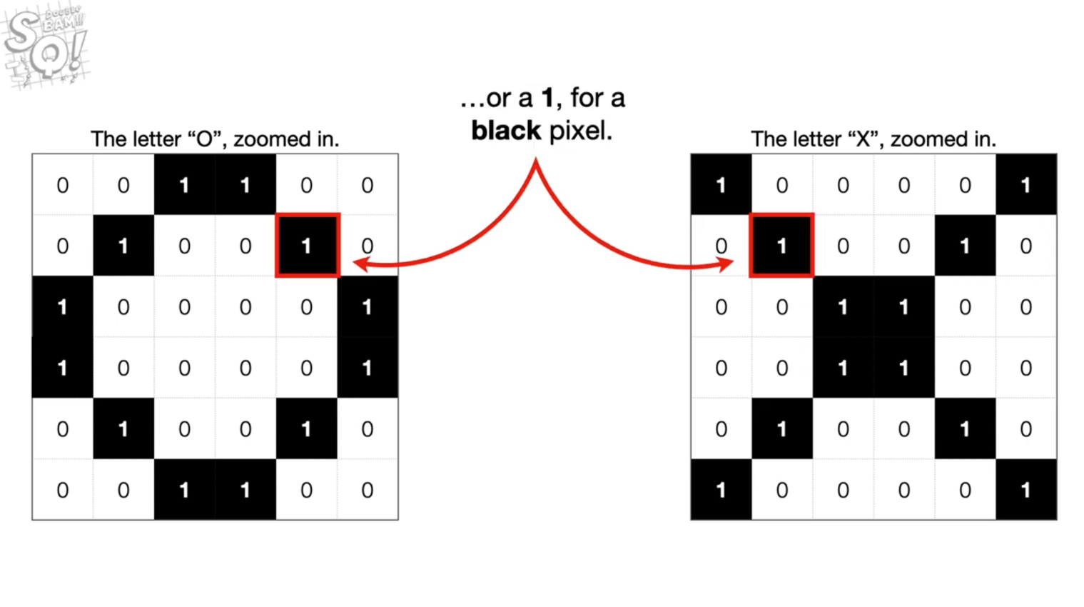
[5]
source : statquest

Slide 6
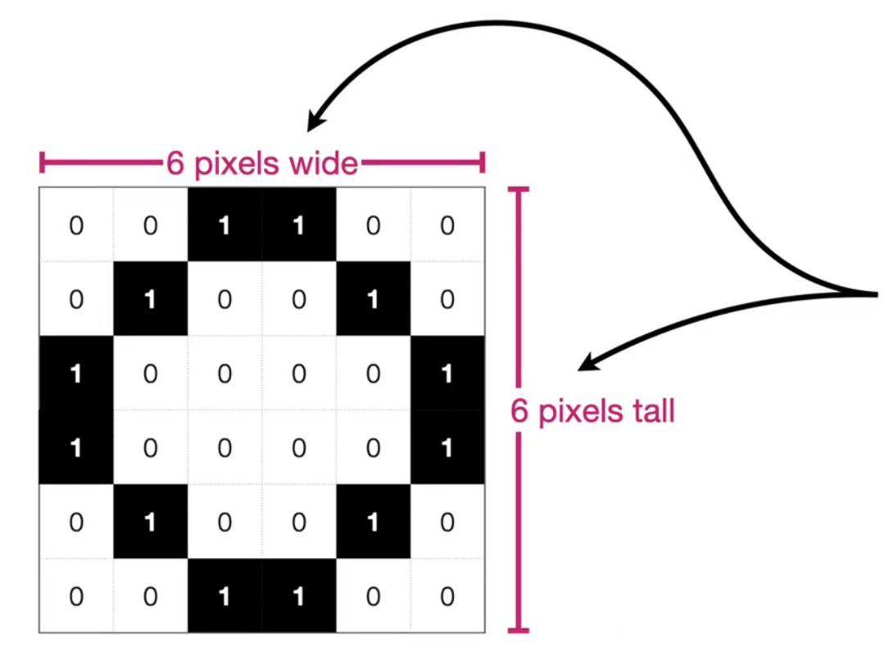
[6]
source : statquest

Slide 7
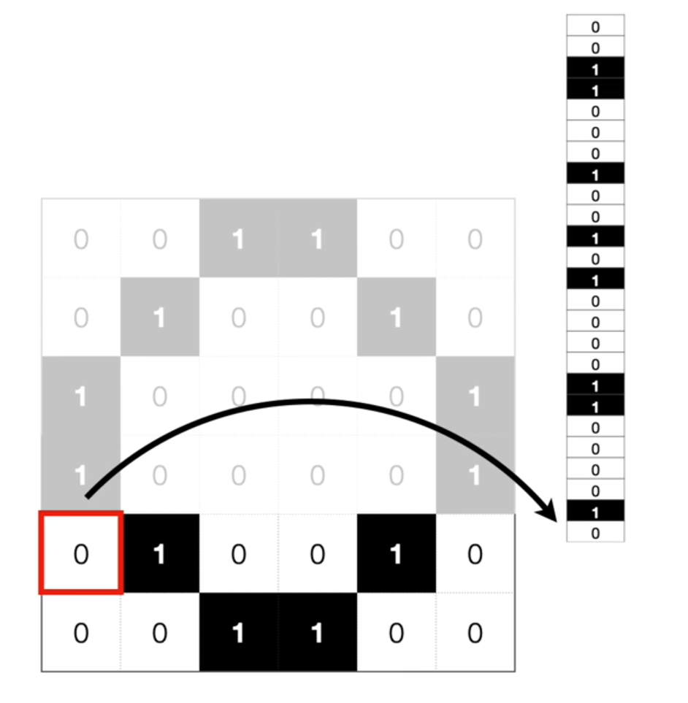
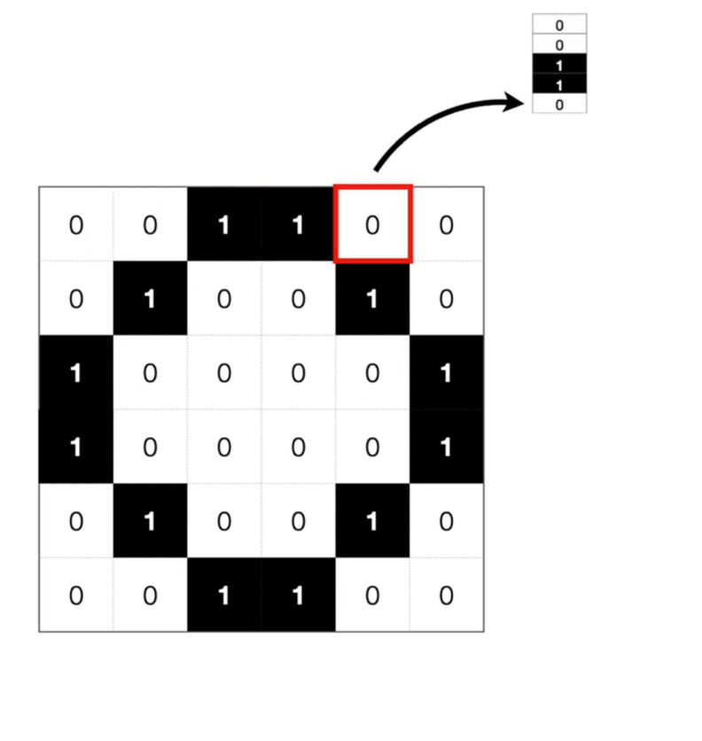
[7]
source : statquest

Slide 8
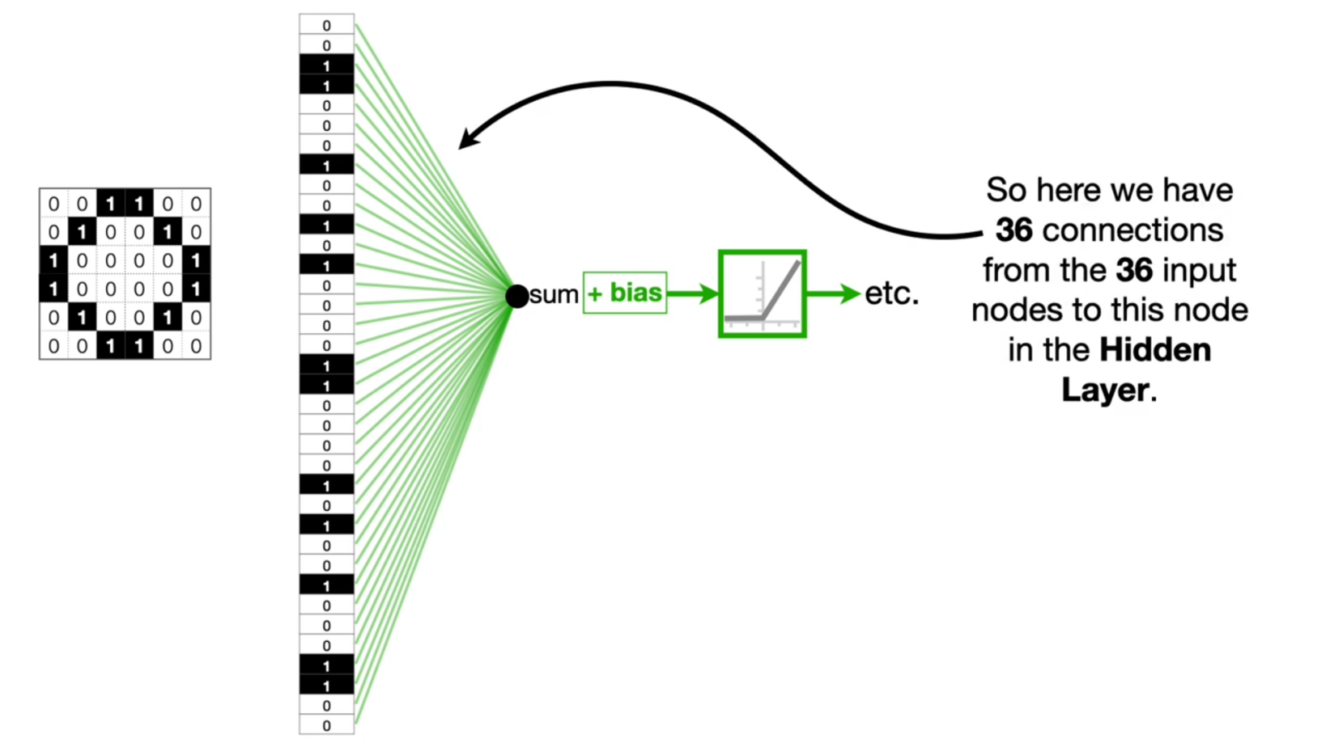
[8]
source : statquest

Slide 9
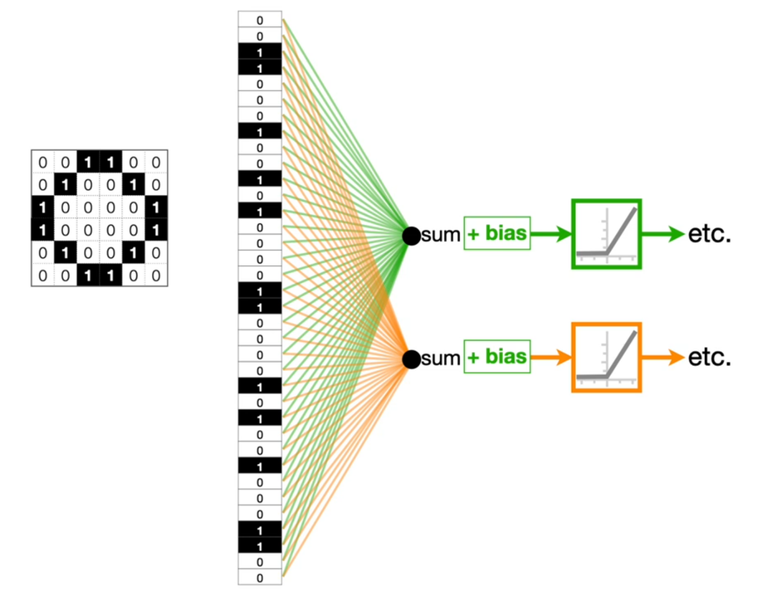
[9]
source : statquest

Slide 10
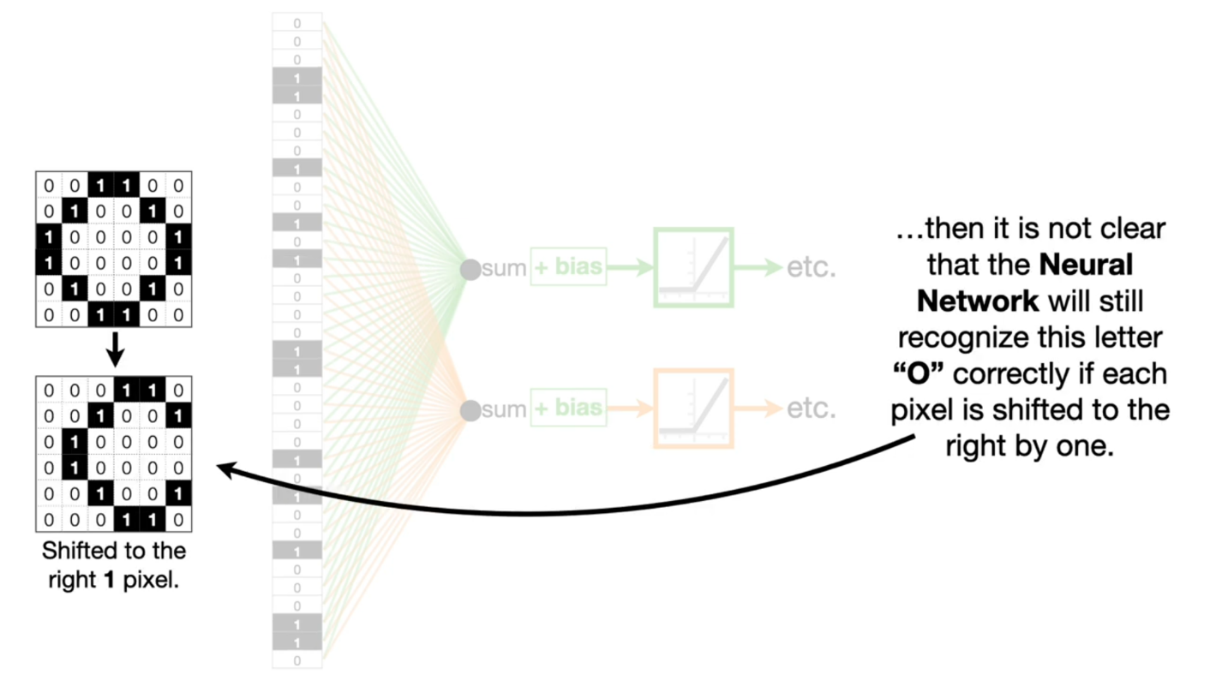
[10]
source : statquest

Slide 11

[11]
source : statquest

Slide 12
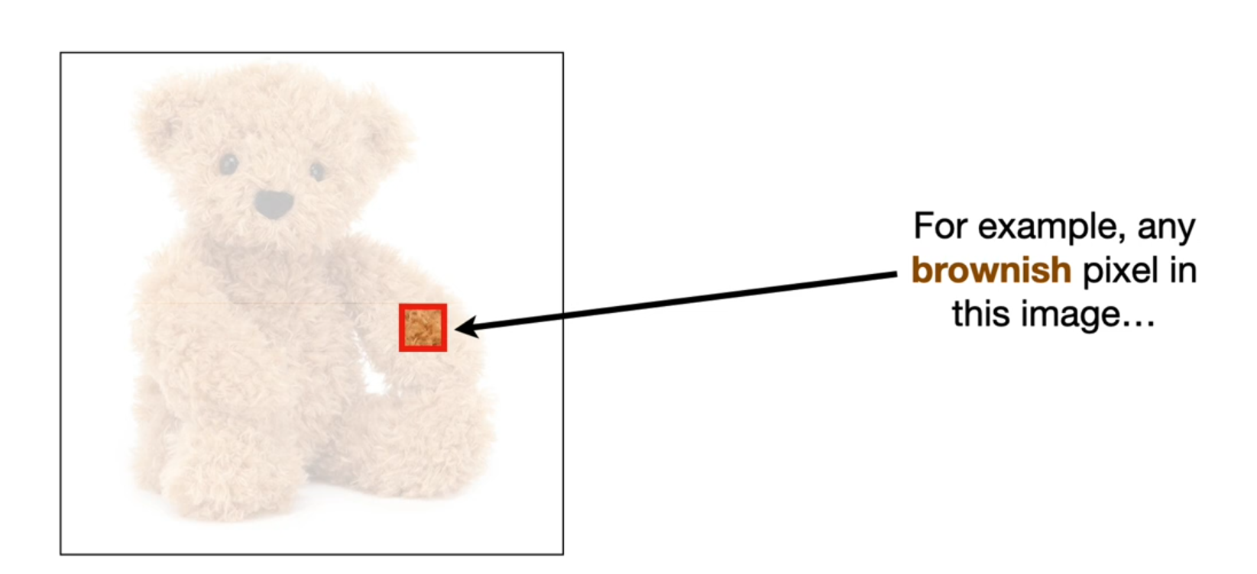
[12]
source : statquest

Slide 13
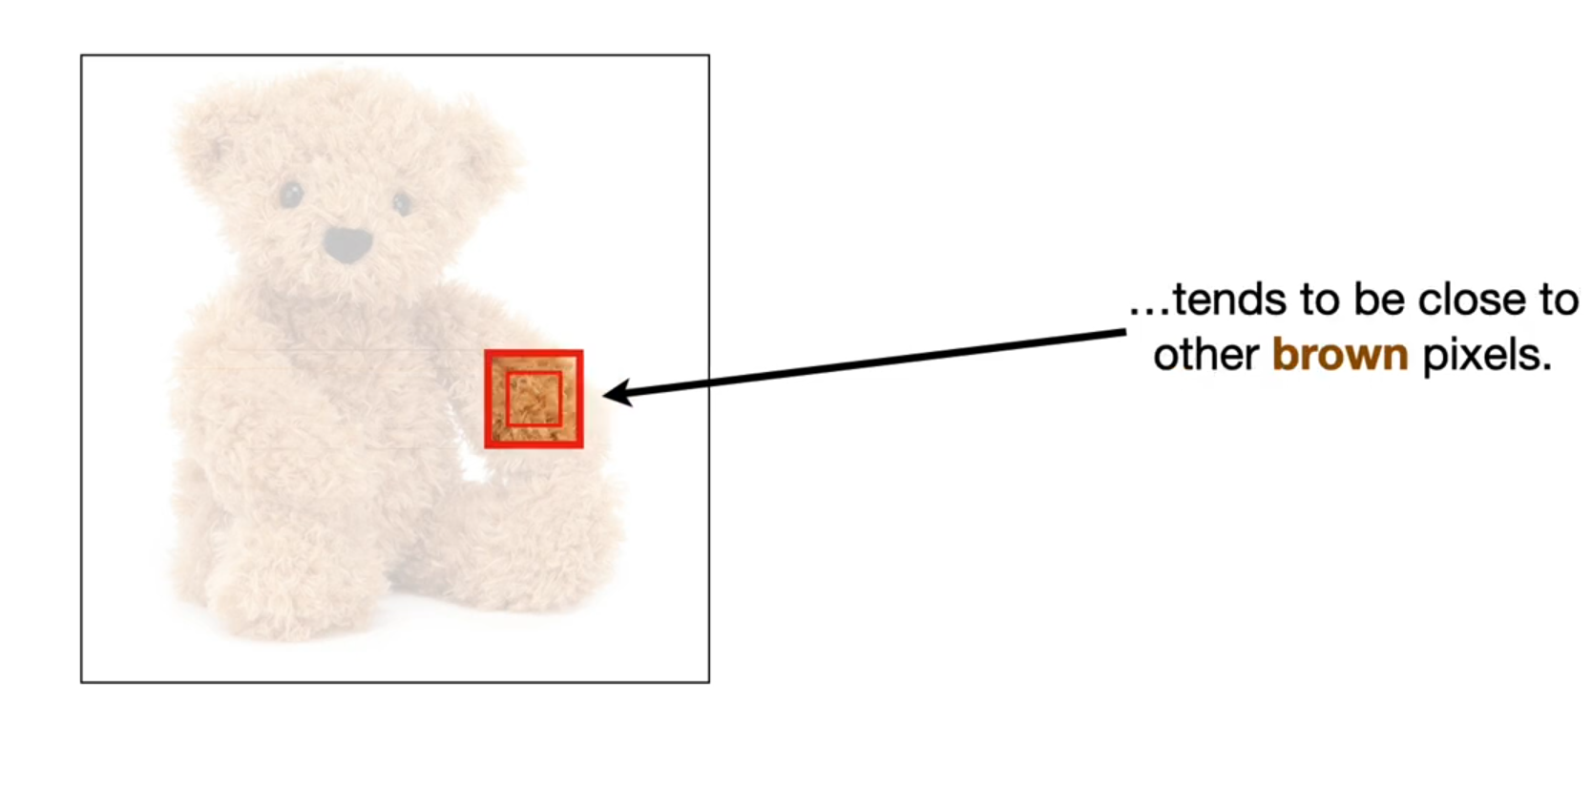
[13]
source : statquest

Slide 14
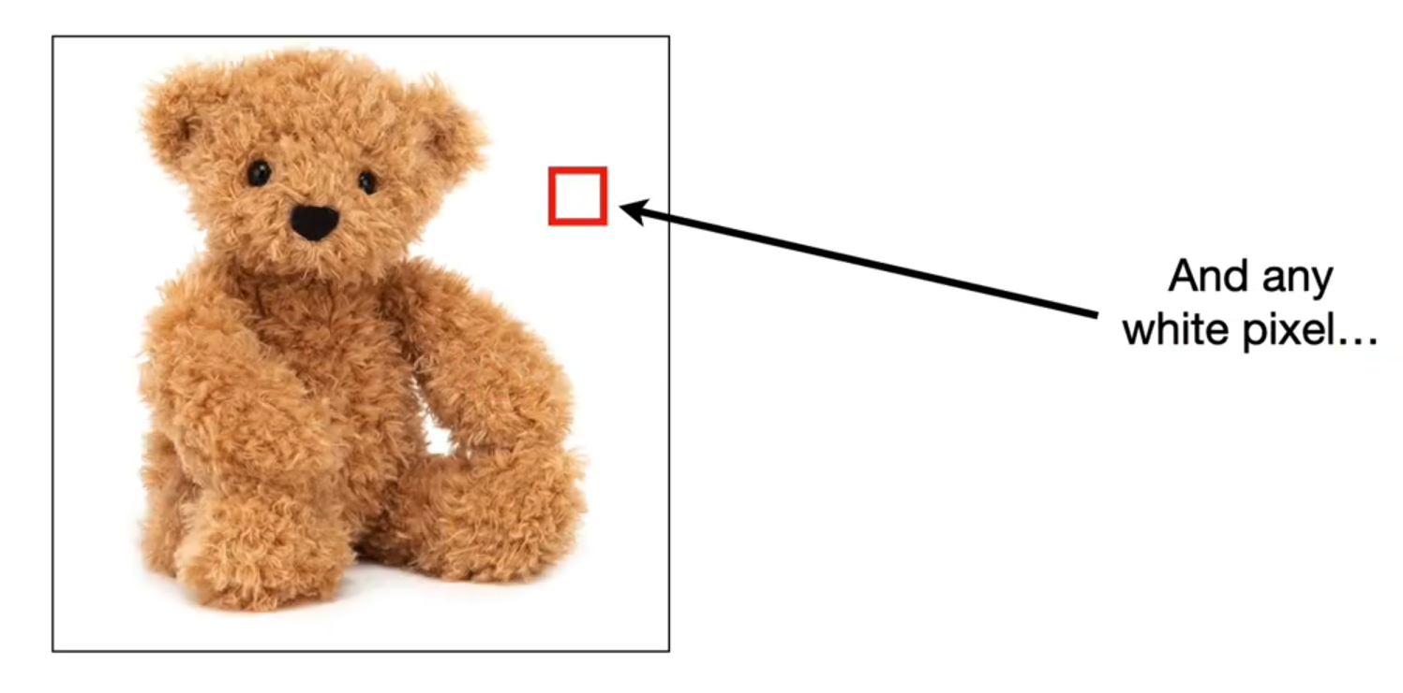
[14]
source : statquest

Slide 15
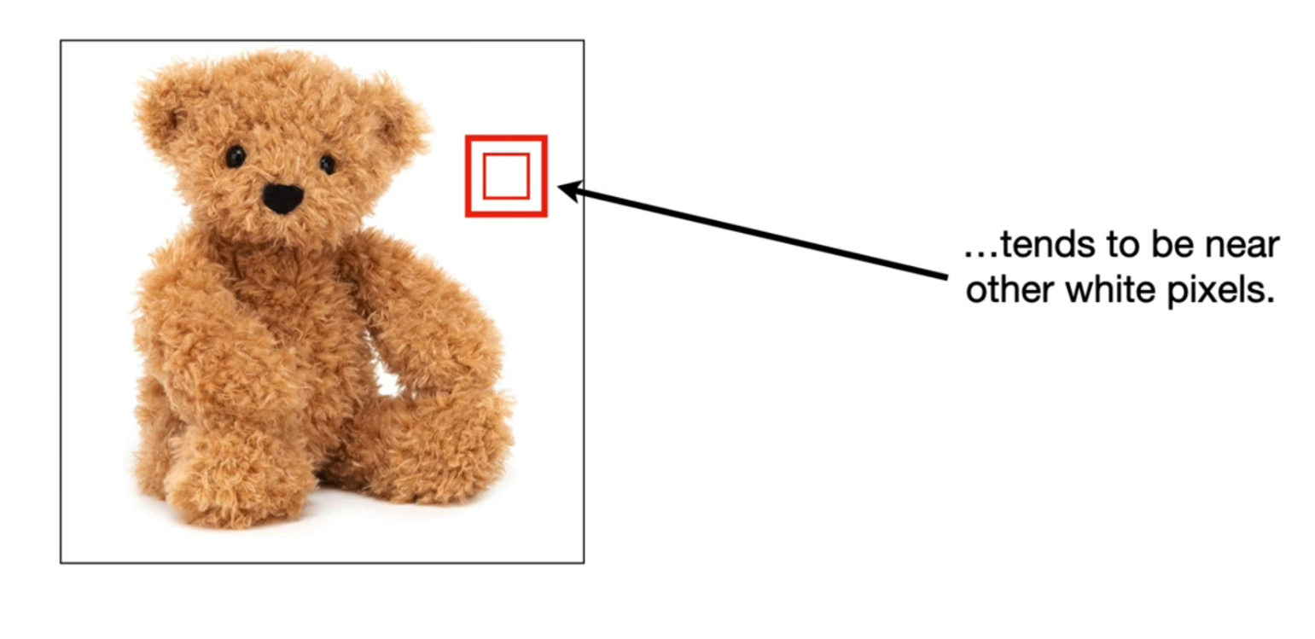
[15]
source : statquest

Slide 16
Convolutional neural networks do three things to make image classification practical :
reduce the number of input nodes
tolerate small shifts in where the pixels are in the image
take advantage of the correlations that we observe in complex images.
[16]
source : statquest

Slide 17
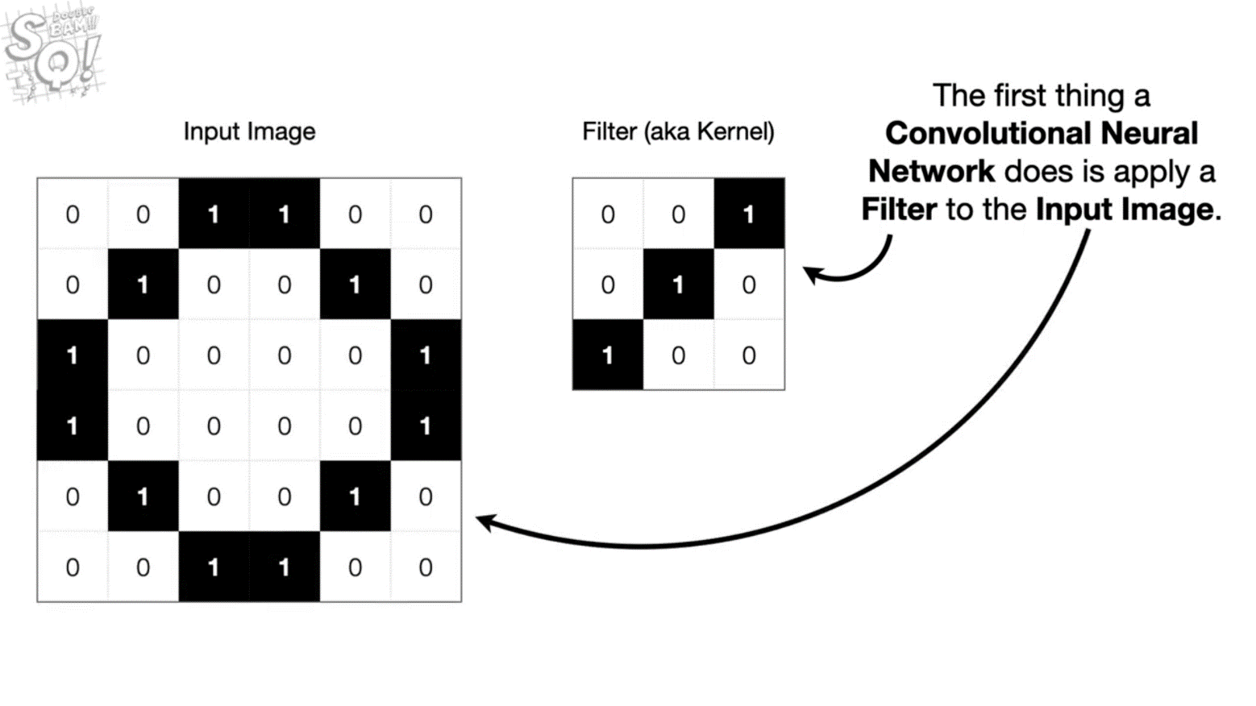
[17]
source : statquest

Slide 18
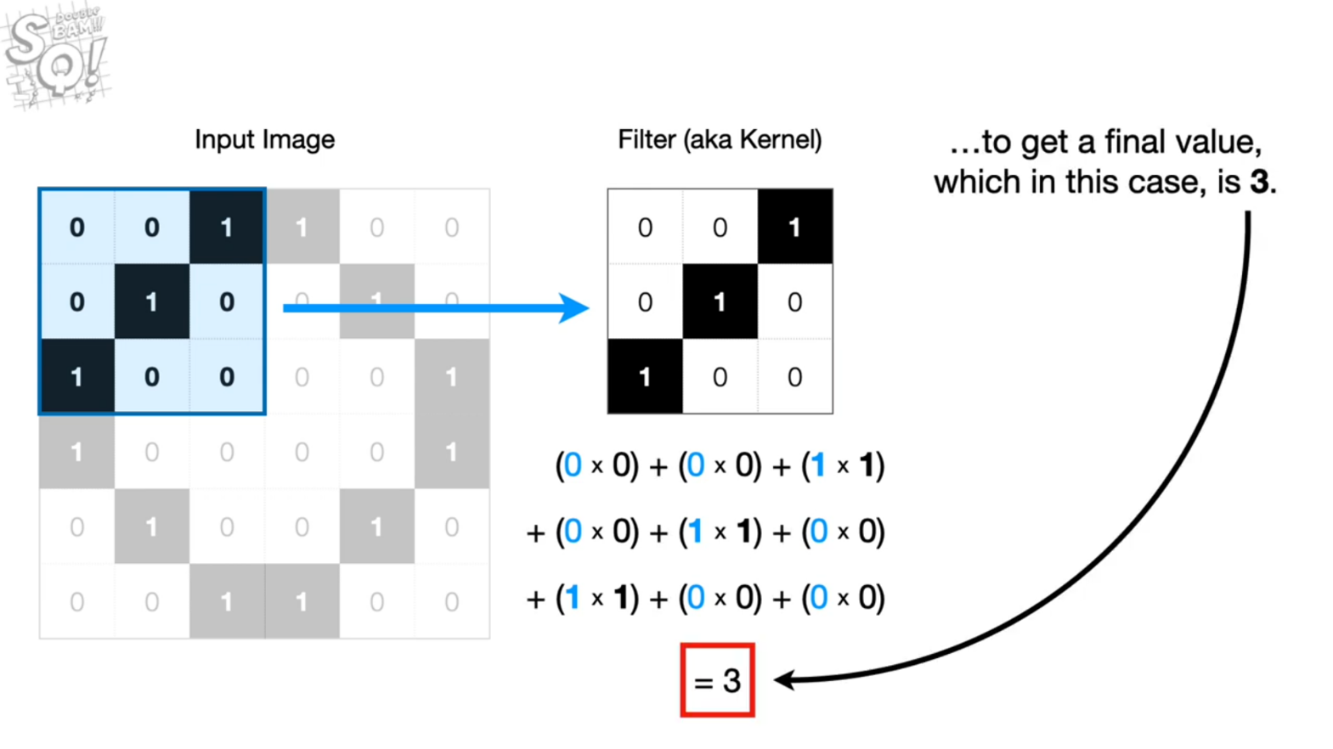
[18]
source : statquest

Slide 19
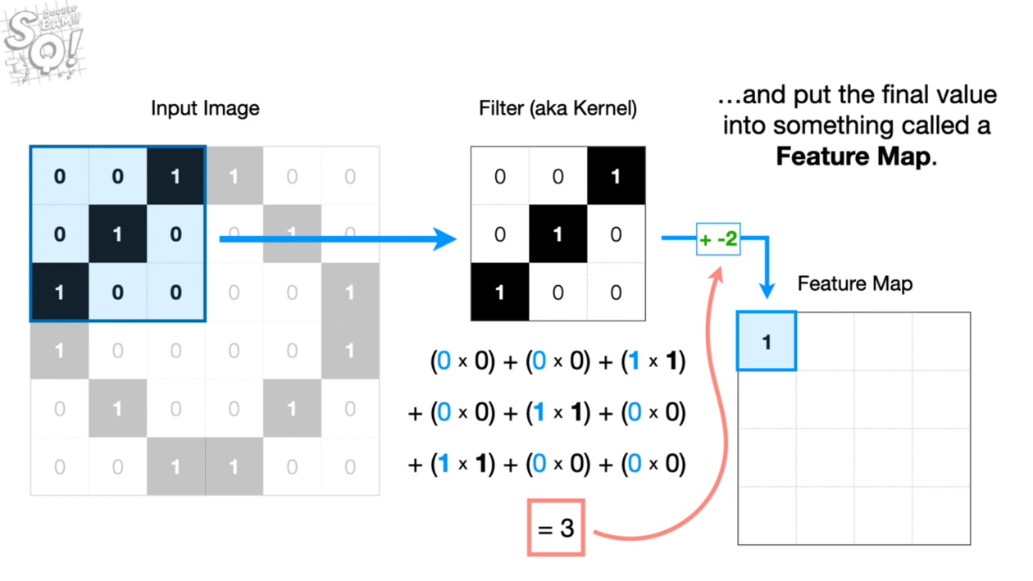
[19]
source : statquest

Slide 20
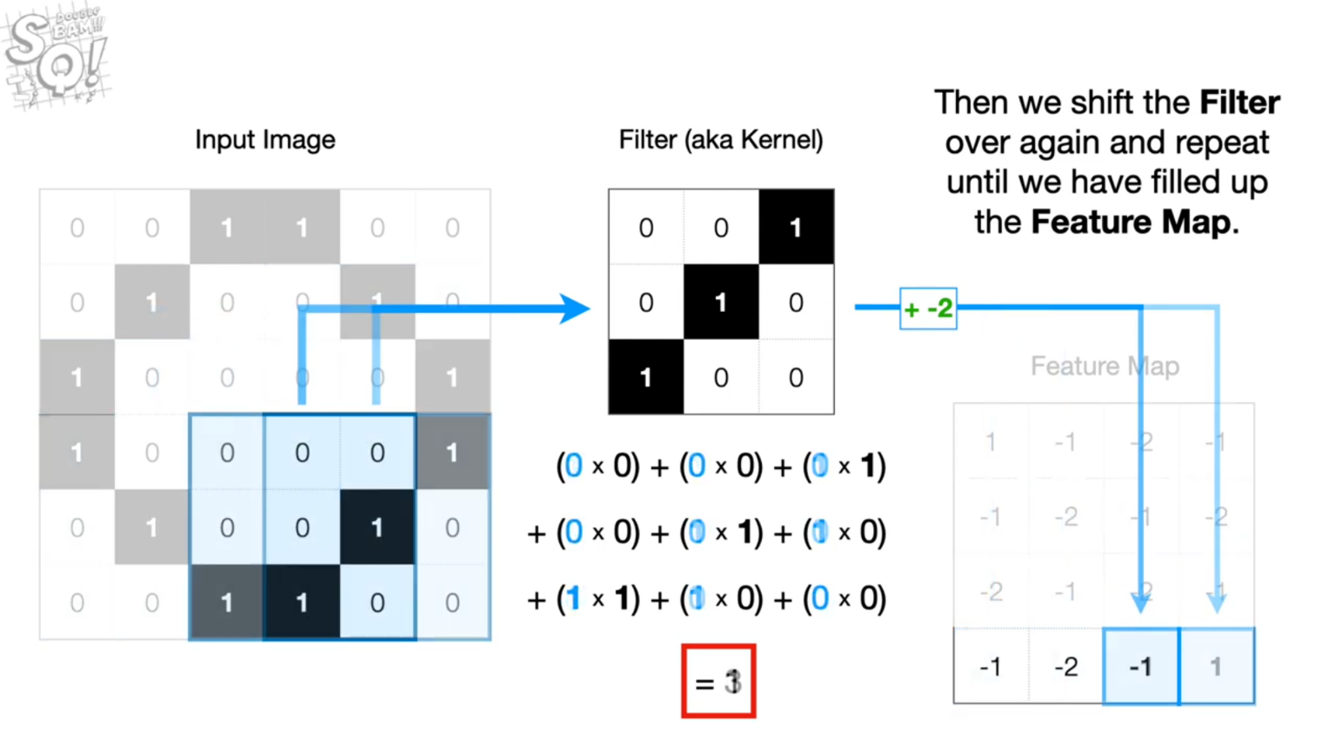
[20]
source : statquest

Slide 21
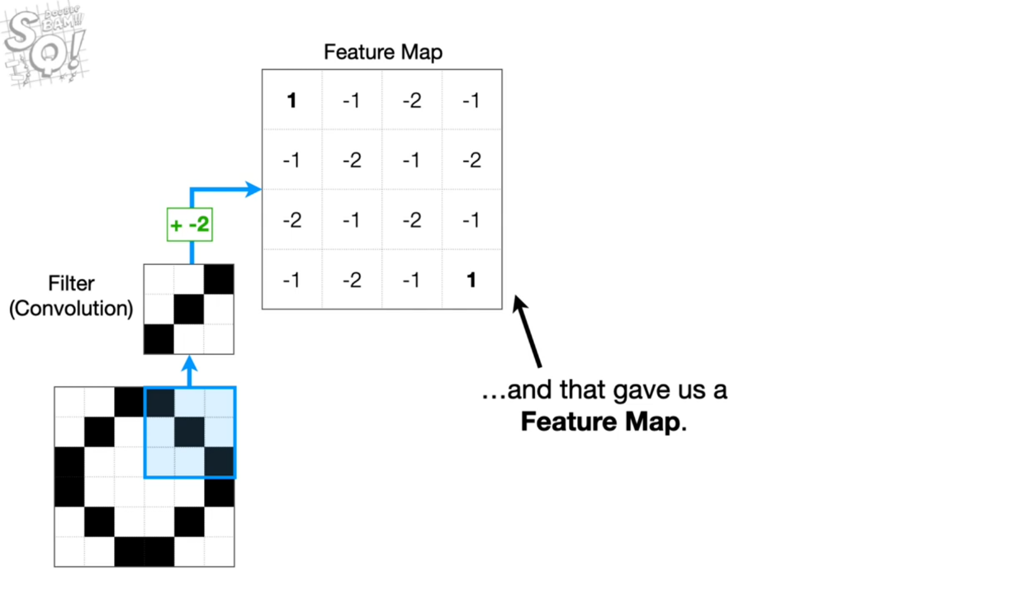
[21]
source : statquest

Slide 22
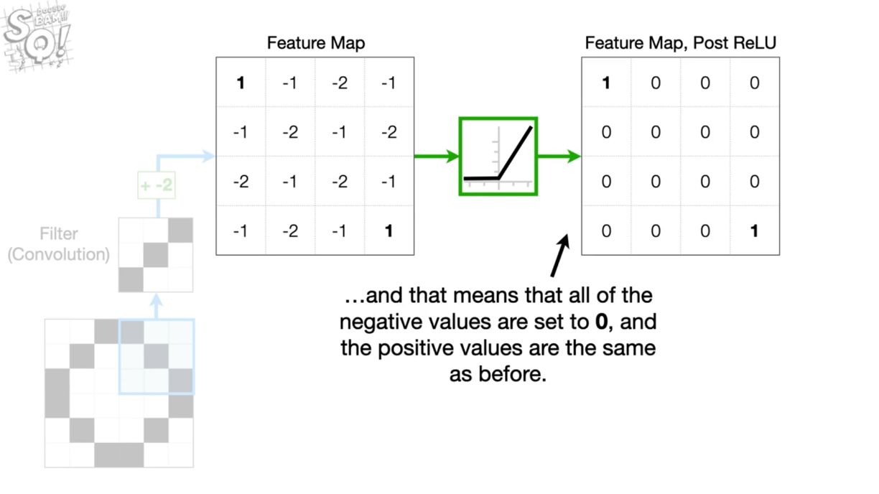
[22]
source : statquest

Slide 23
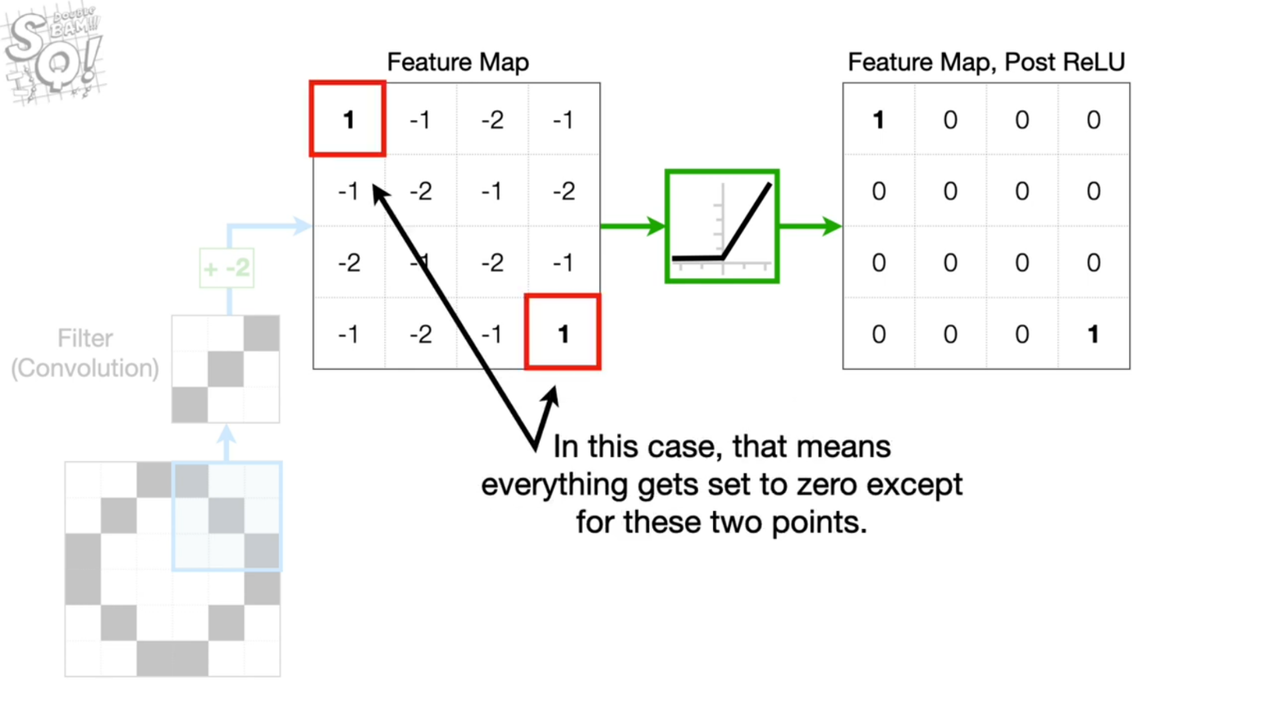
[23]
source : statquest

Slide 24
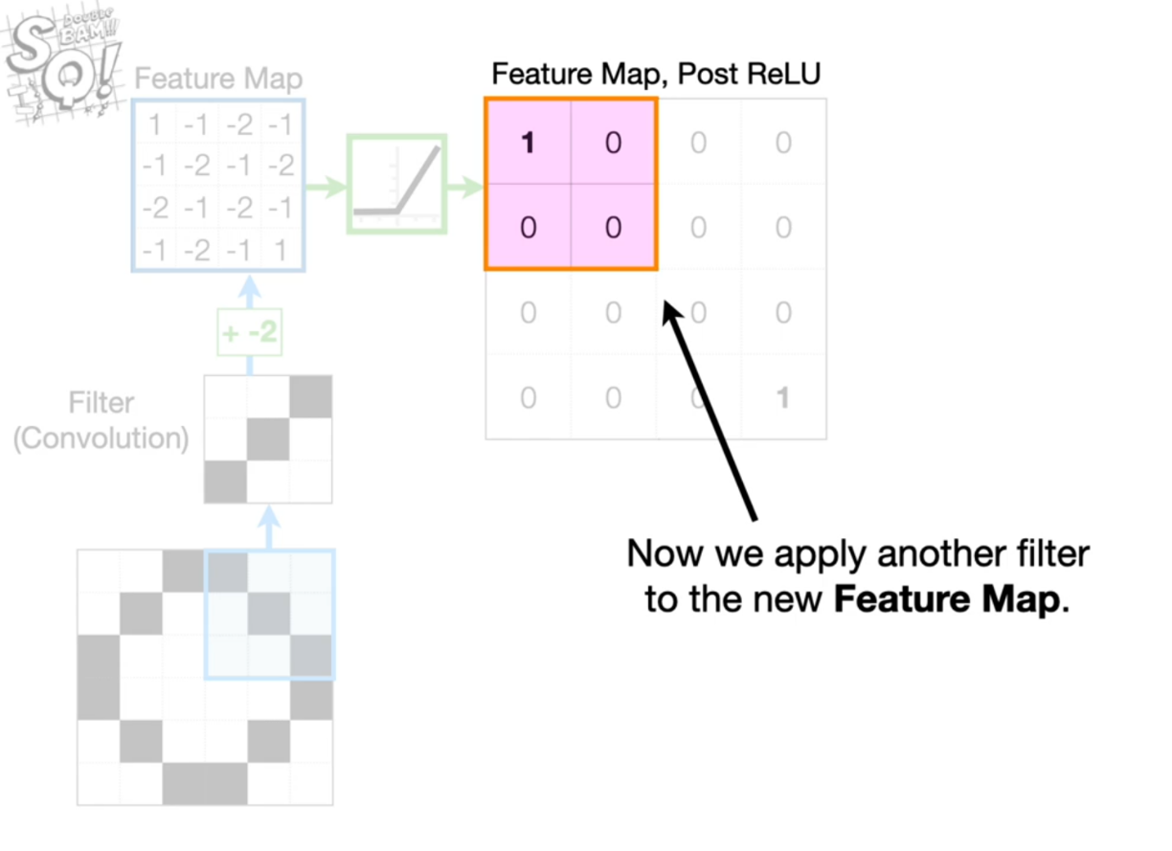
[24]
source : statquest

Slide 25
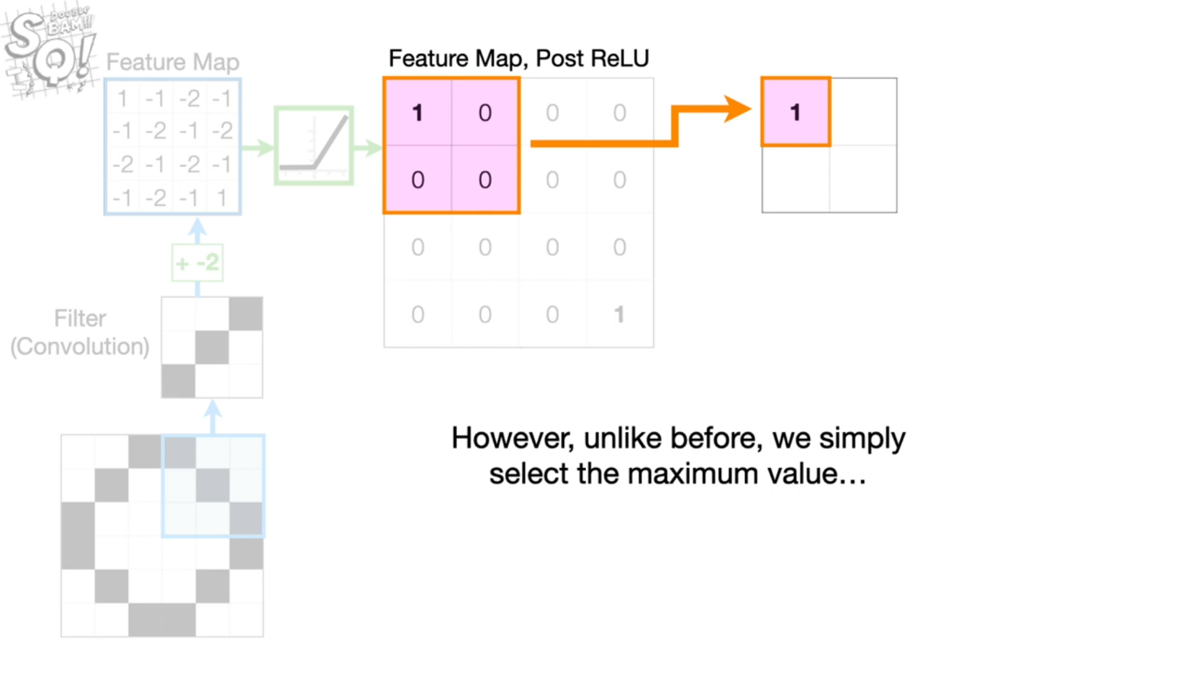
[25]
source : statquest

Slide 26
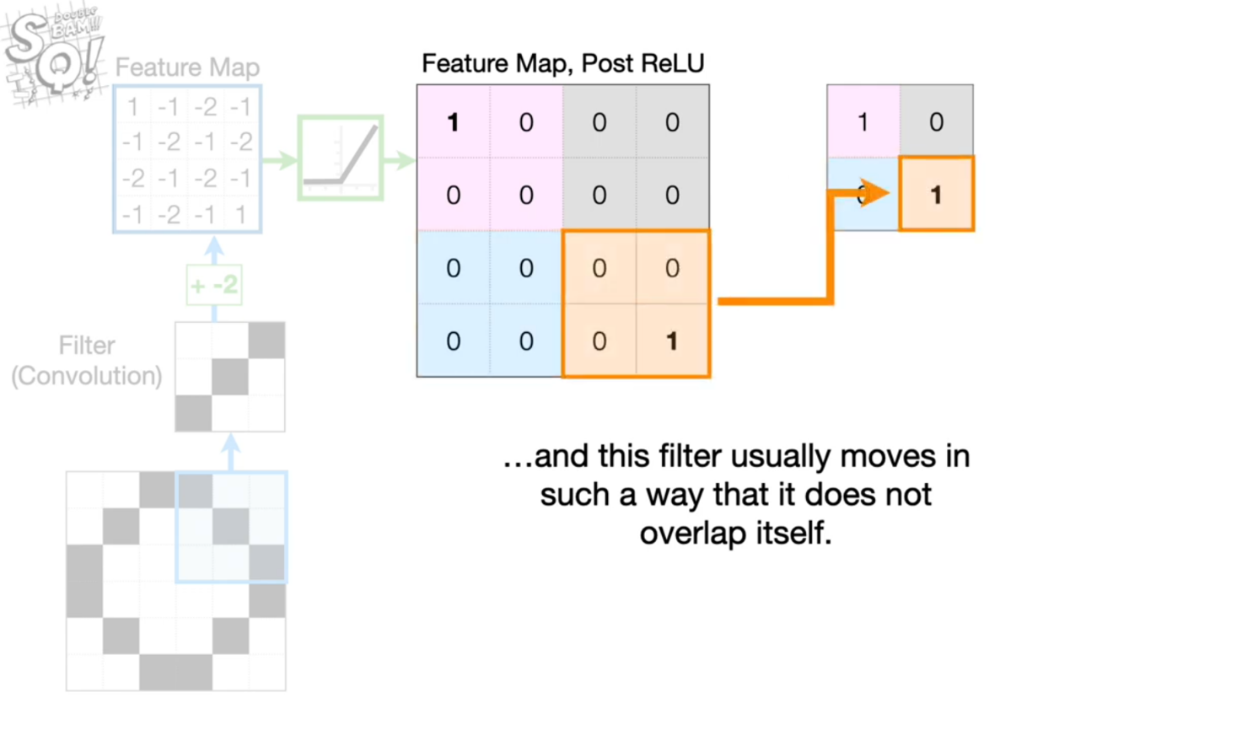
Max Pooling
[26]
source : statquest

Slide 27
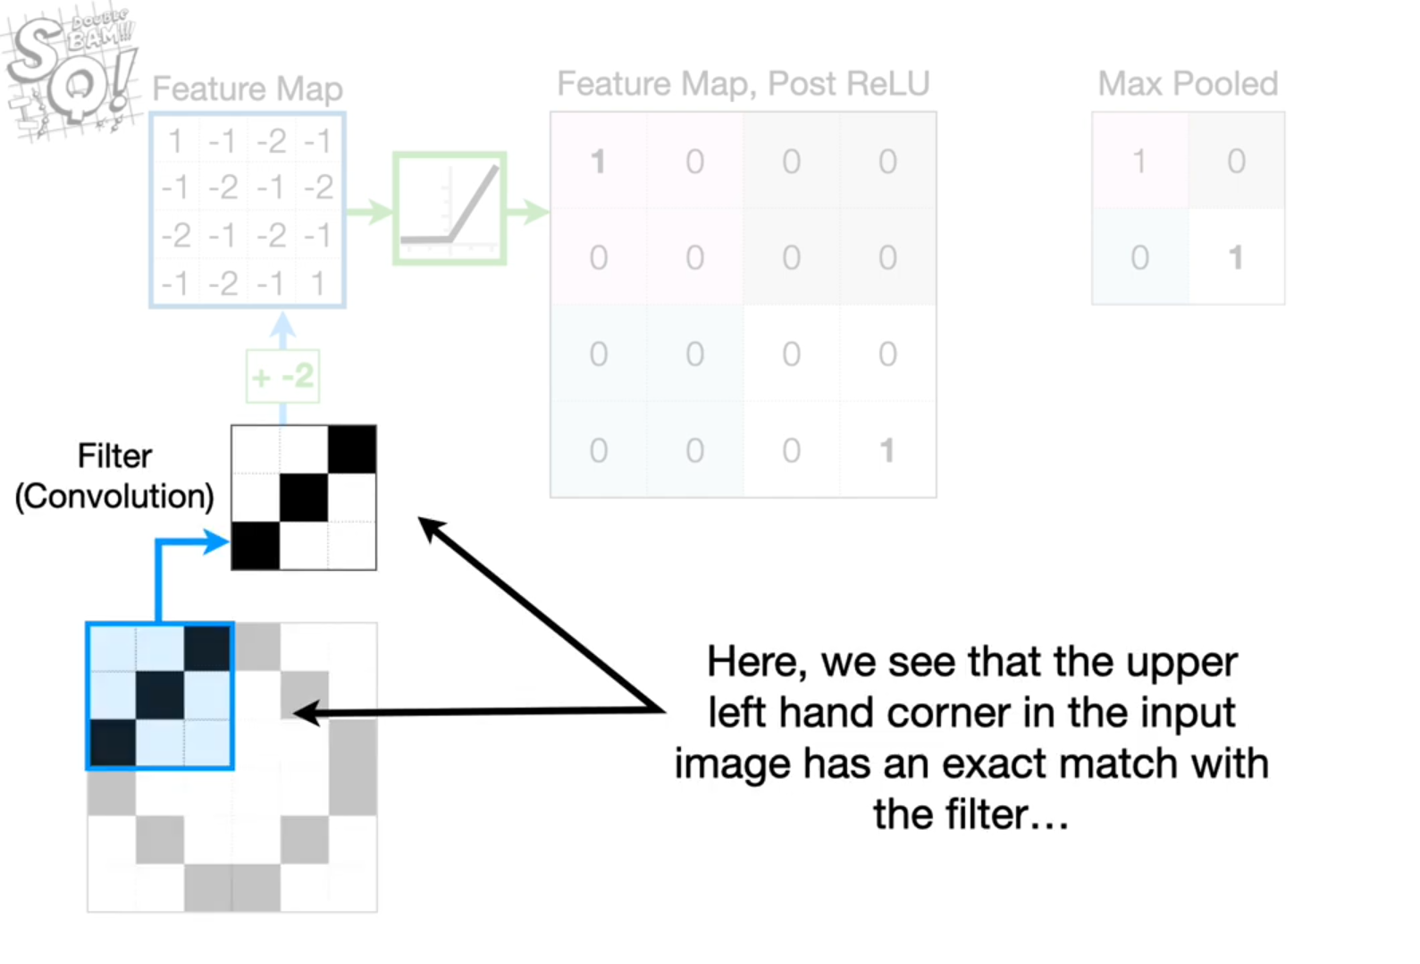
[27]
source : statquest

Slide 28
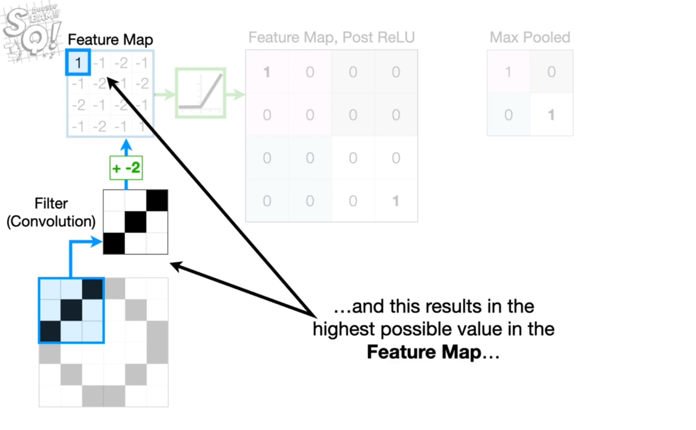
[28]
source : statquest

Slide 29
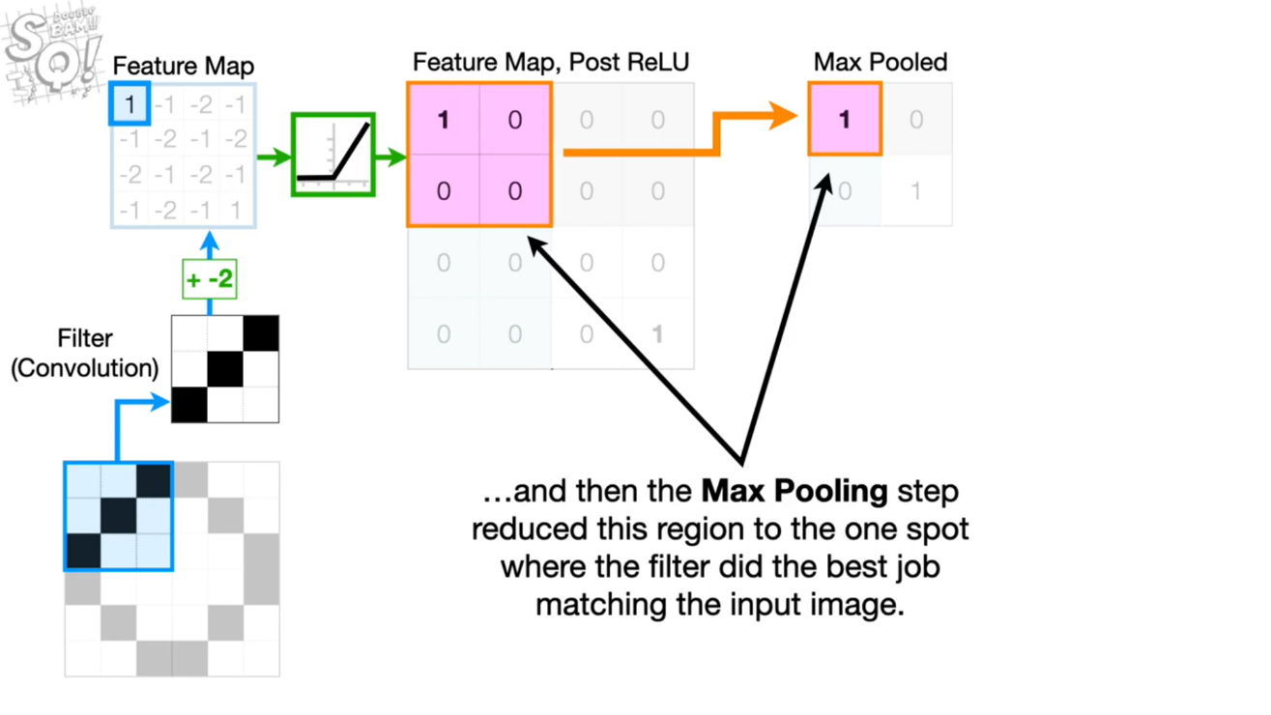
[29]
source : statquest

Slide 30
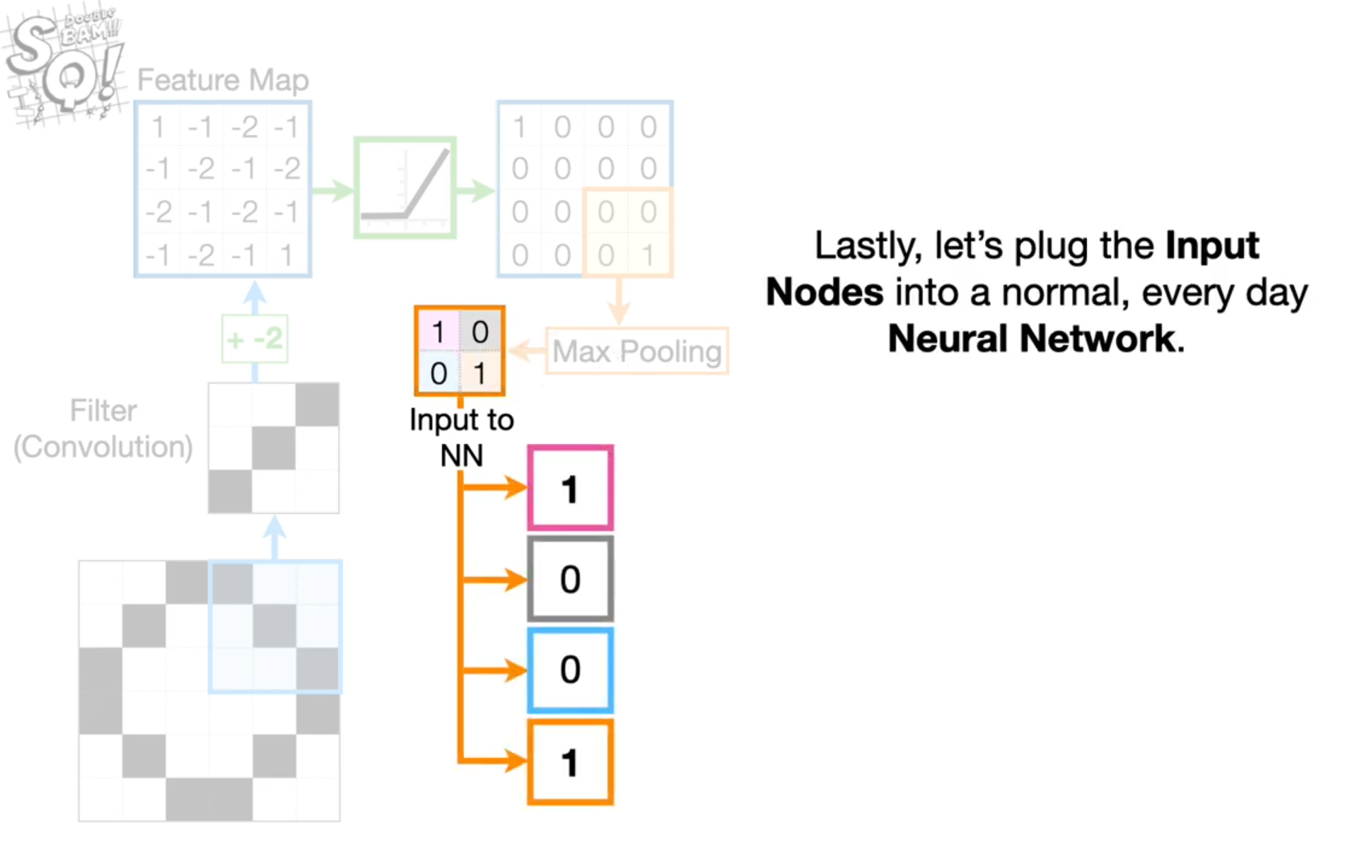
[30]
source : statquest

Slide 31
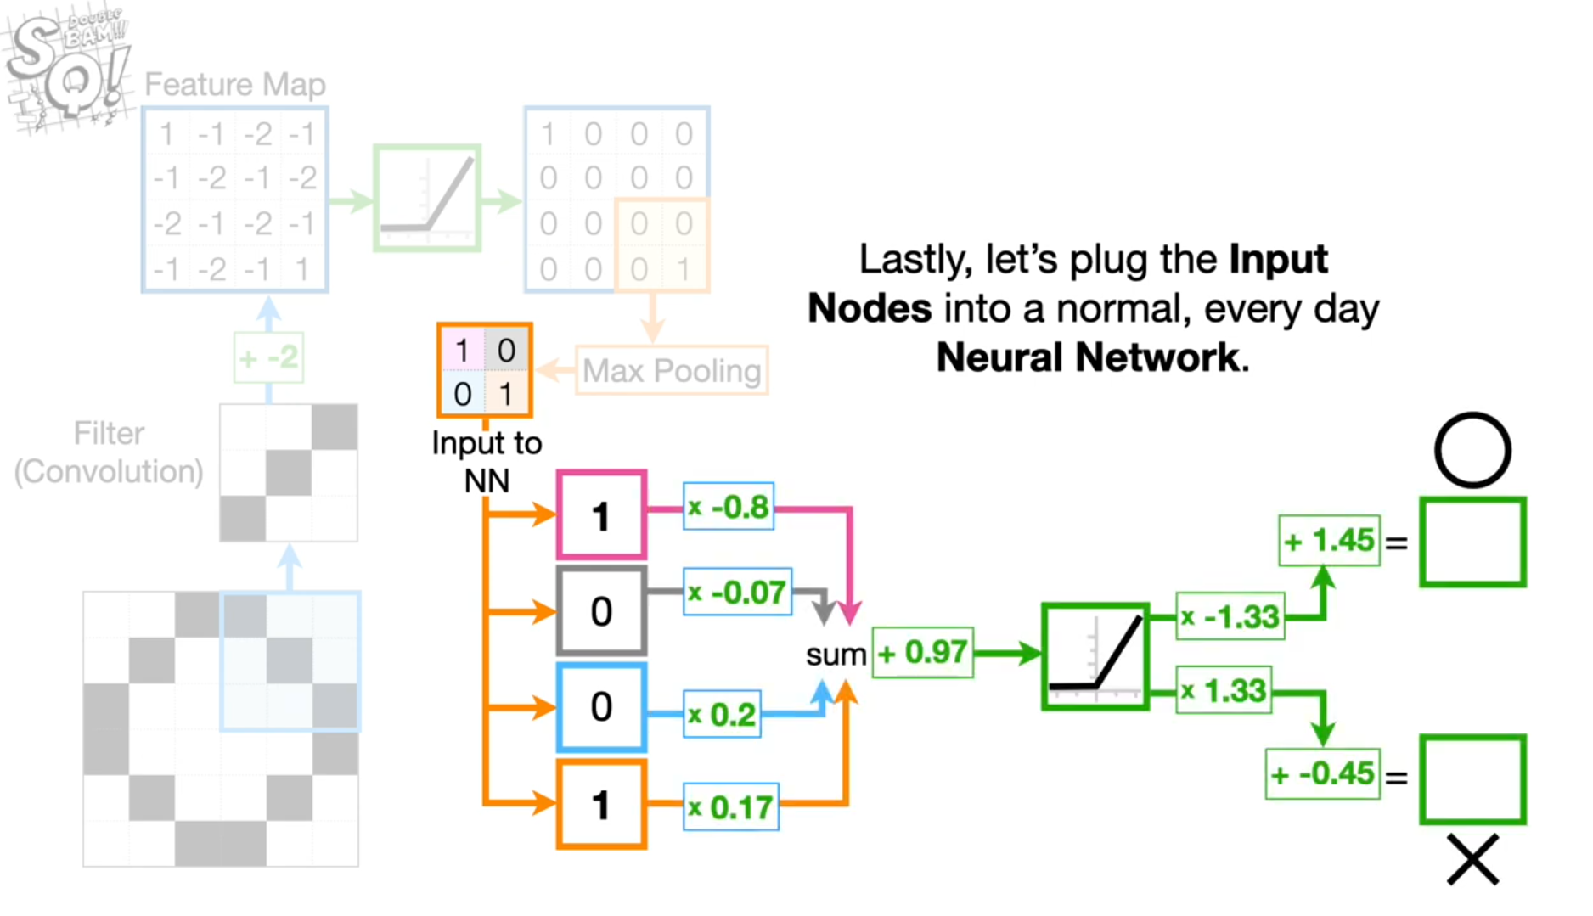
[31]
source : statquest

Slide 32
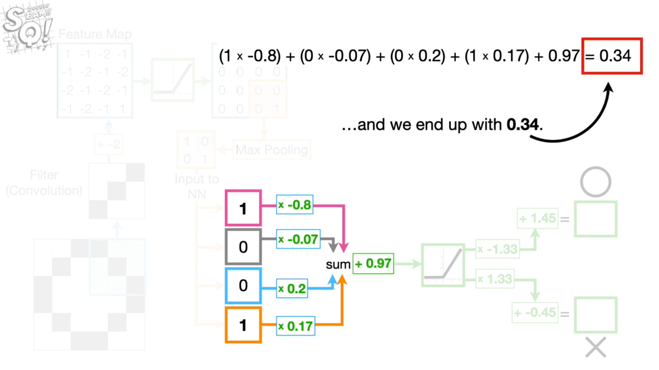
[32]
source : statquest

Slide 33
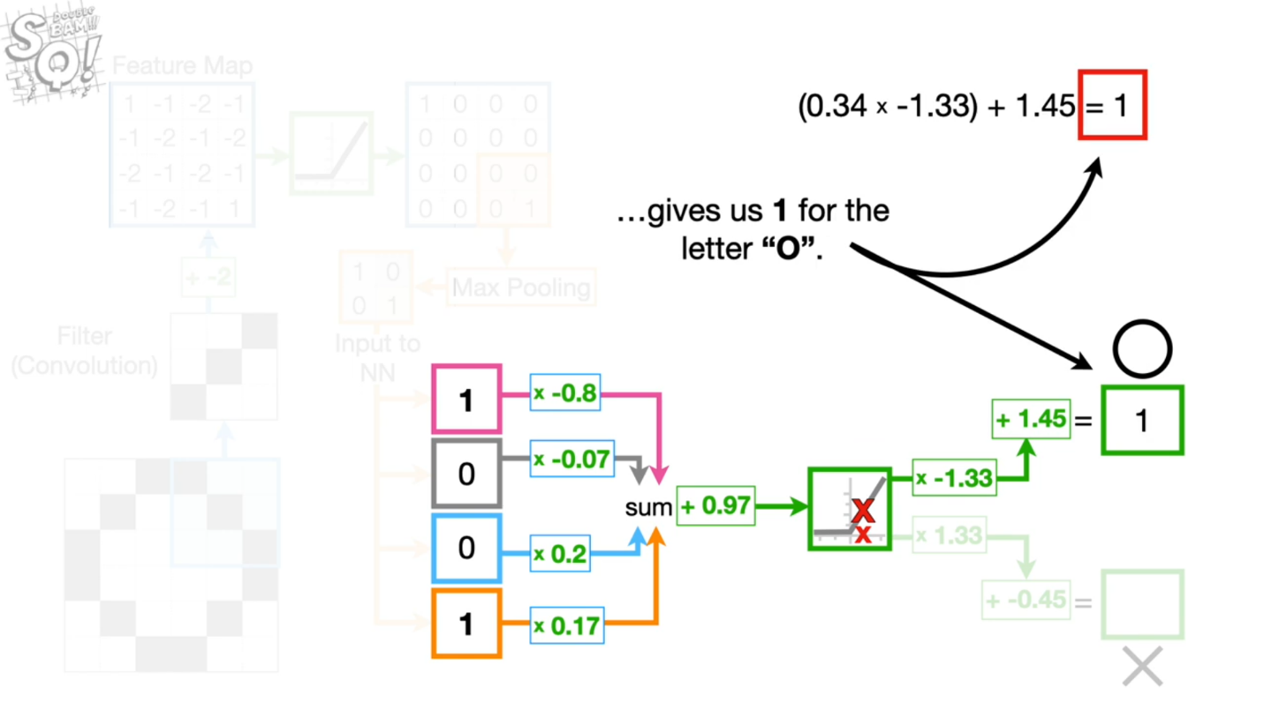
[33]
source : statquest

Slide 34
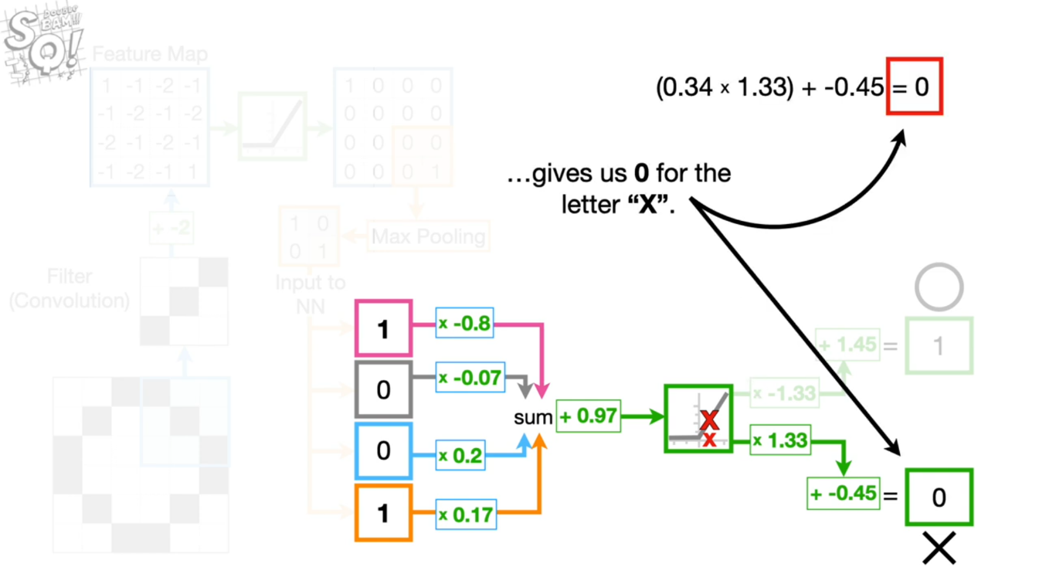
[34]
source : statquest

Slide 35
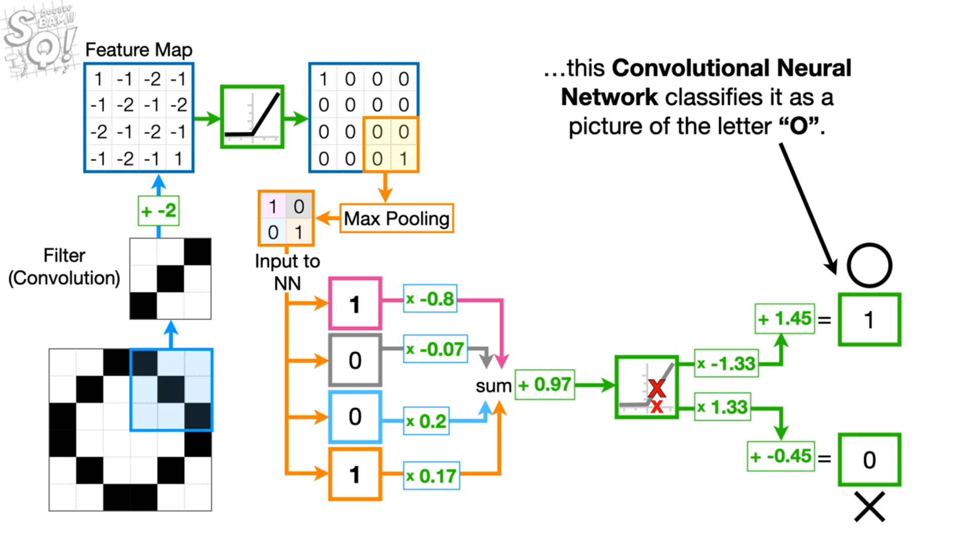
[35]
source : statquest

Slide 36

[36]
source : giphy.com

Slide 37
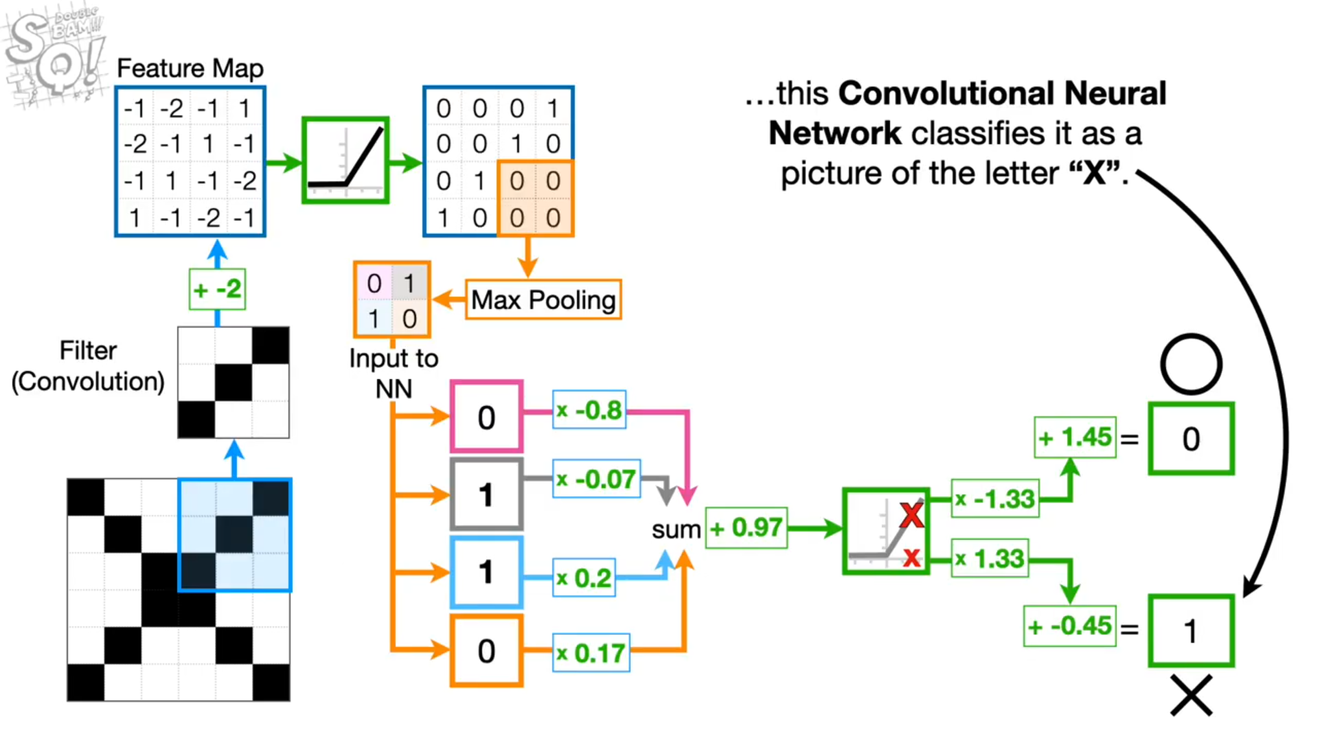
[37]
source : statquest

Slide 38
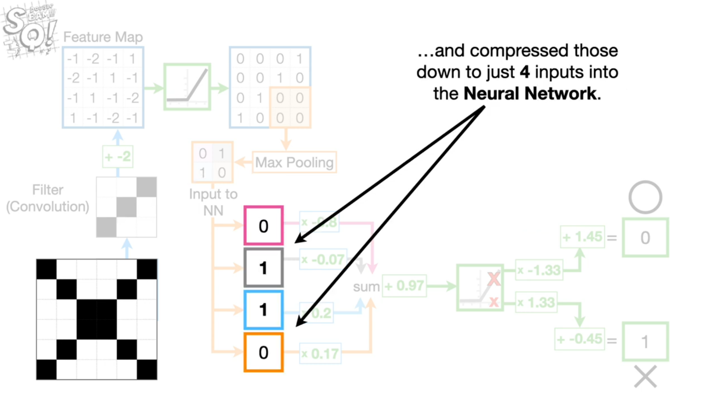
[38]
source : statquest

Slide 39
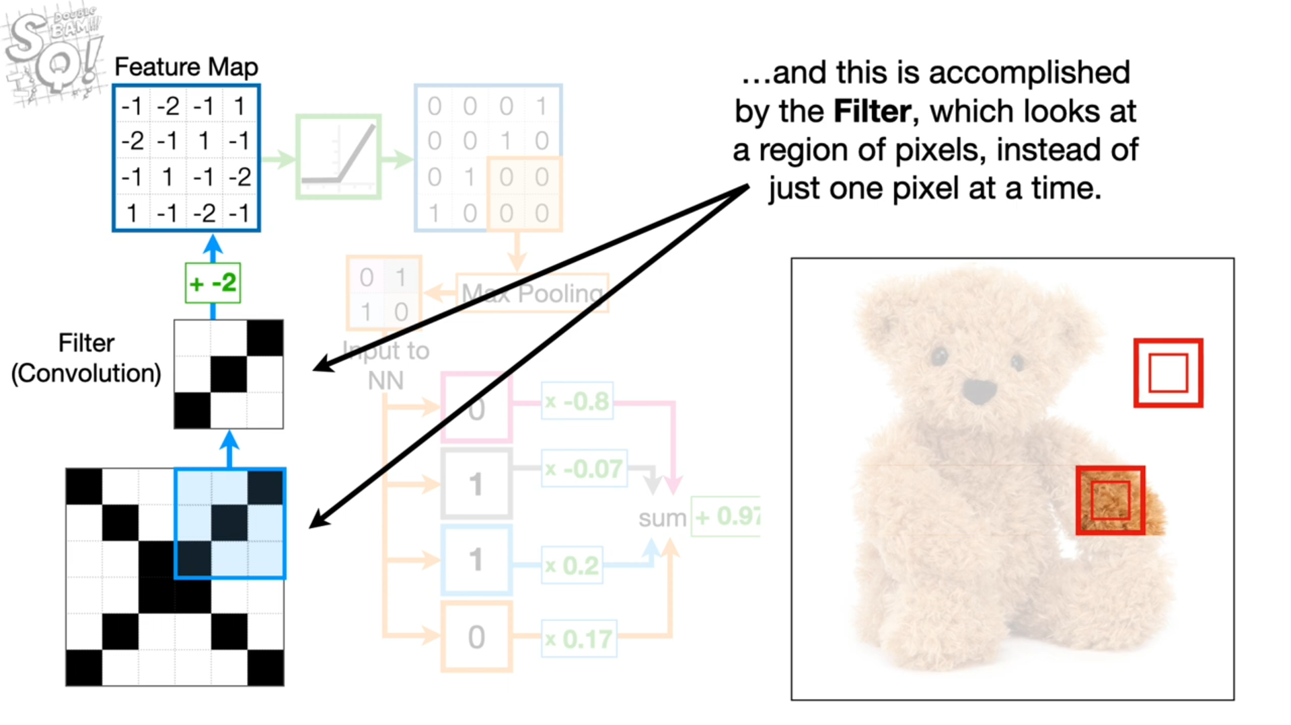
[39]
source : statquest

Slide 40
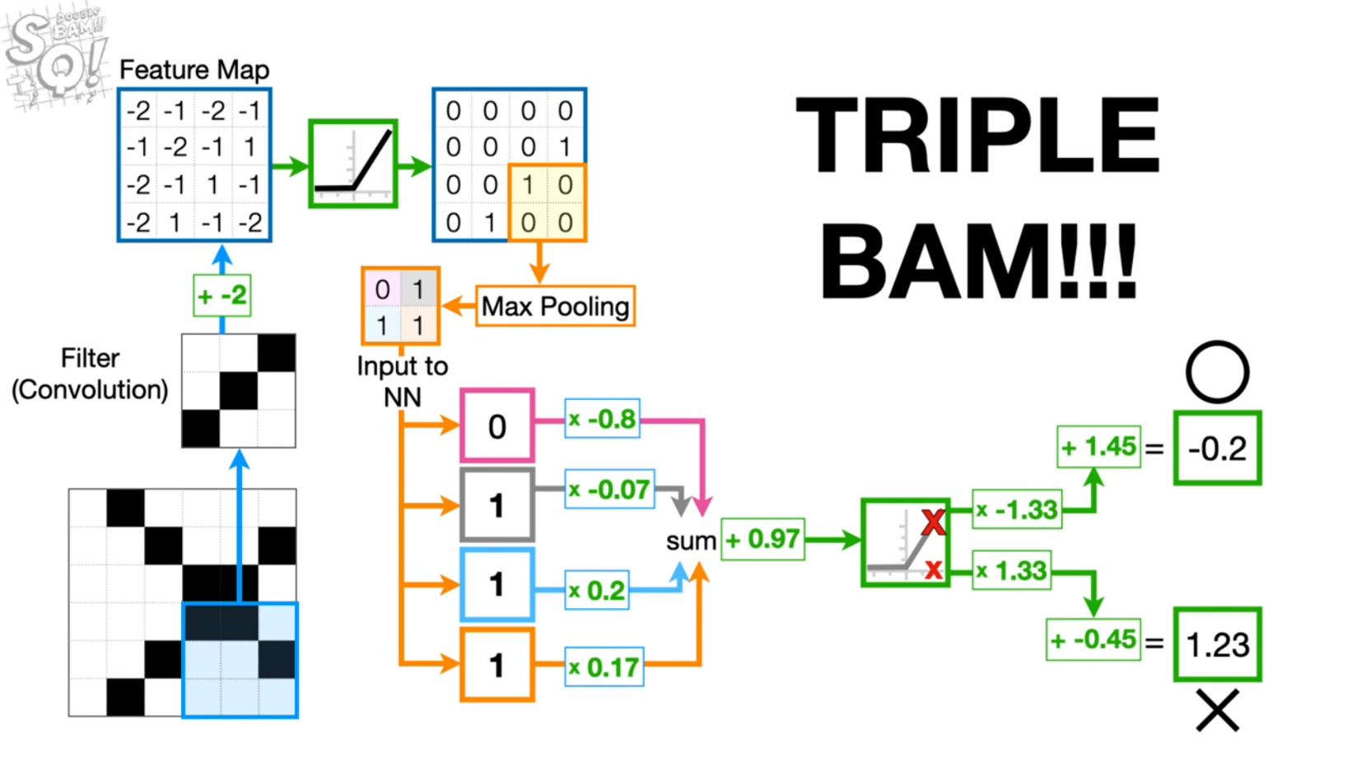
[40]
source : statquest

Slide 41
References
[1]https://www.youtube.com/watch?v=HGwBXDKFk9I&t=460s&ab_channel=StatQuestwithJoshStarmer [Accessed on 7 Feb 2022 ]
[2] https://www.educba.com/convolutional-neural-networks/ [Accessed on 7 Feb 2022 ]
[41]

Slide 42
Thank You.
[42]

